Slide 1
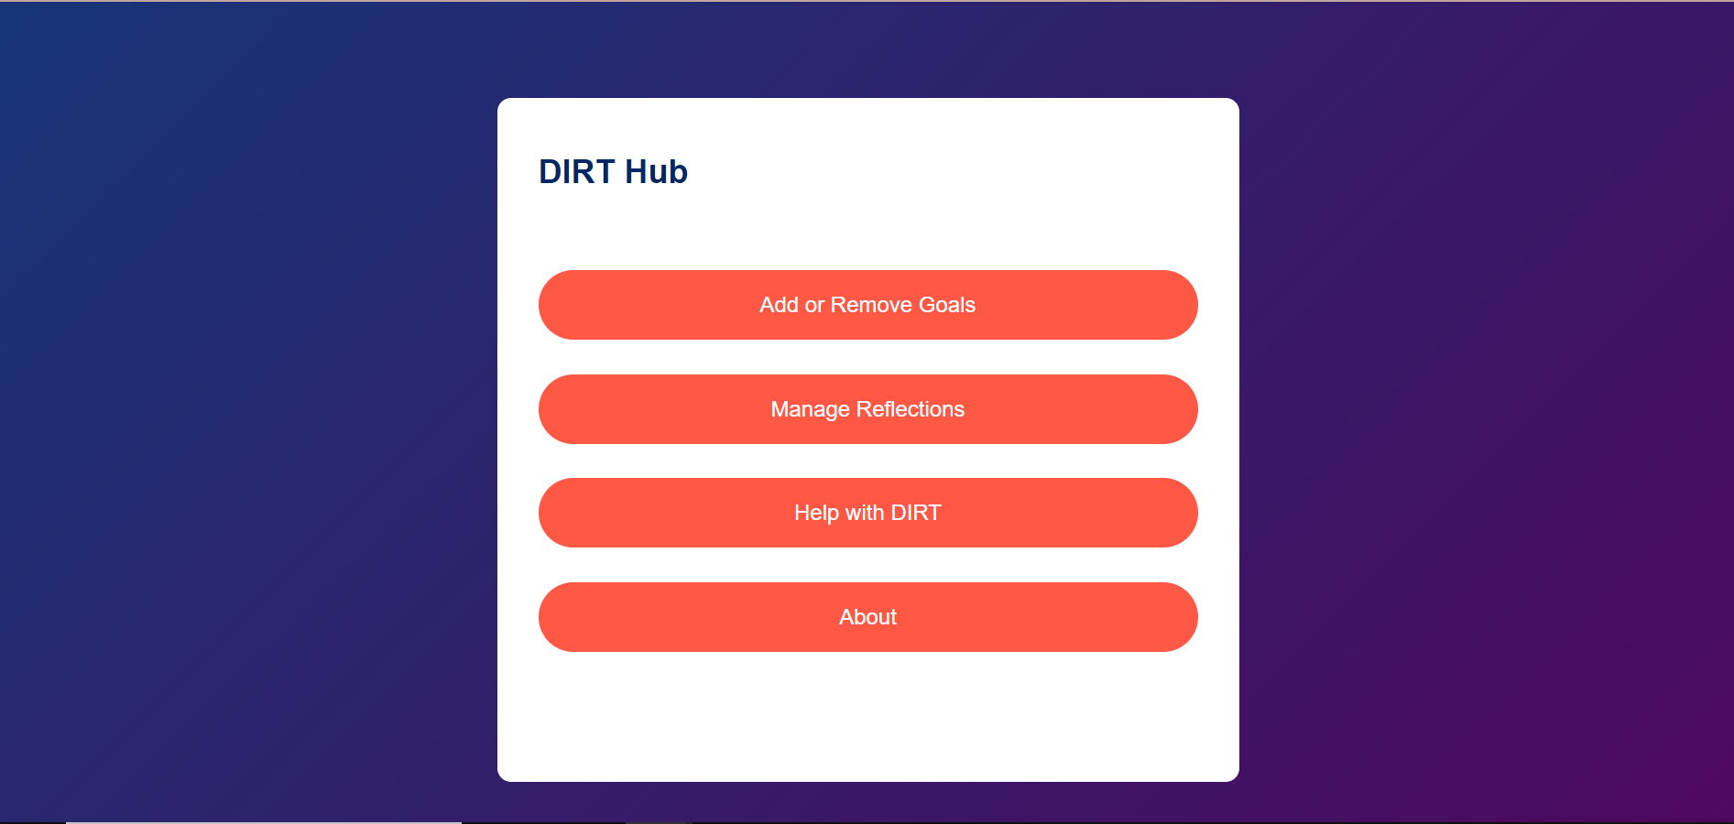
DIRT Hub – a reflection tool for students
By Ben Chapman

Slide 2
Outline
DIRT stands for Dedicated Improvement and Reflection Time. It is a strategy used in education, particularly in the UK, to enhance student learning by giving them structured time to reflect on their work, respond to feedback, and make improvements.
This project encourages students to utilise this tool by providing a convenient location for students to log reflections on their work and actionable goals so that they are able to revisit their reflections at a later date and are able to remind themselves of key things they need to remember going forwards.

Slide 3

Home Page

Slide 4
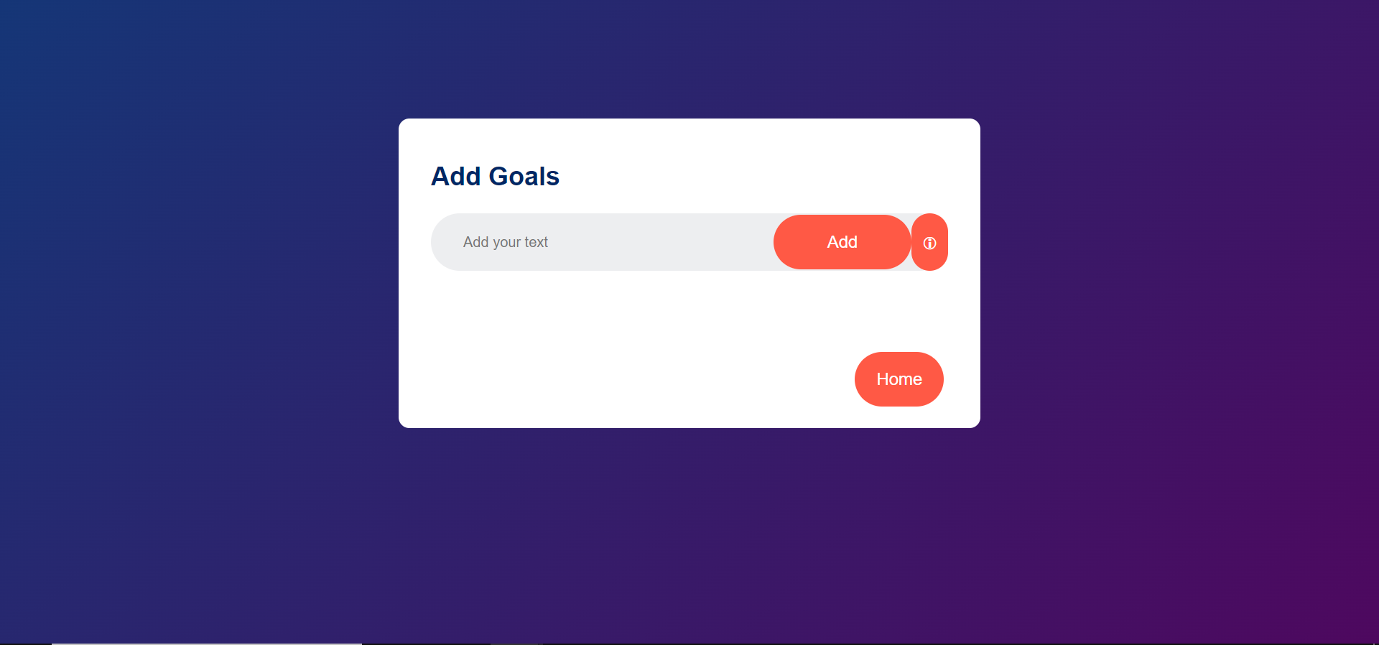
Add or Remove Goals

Slide 5
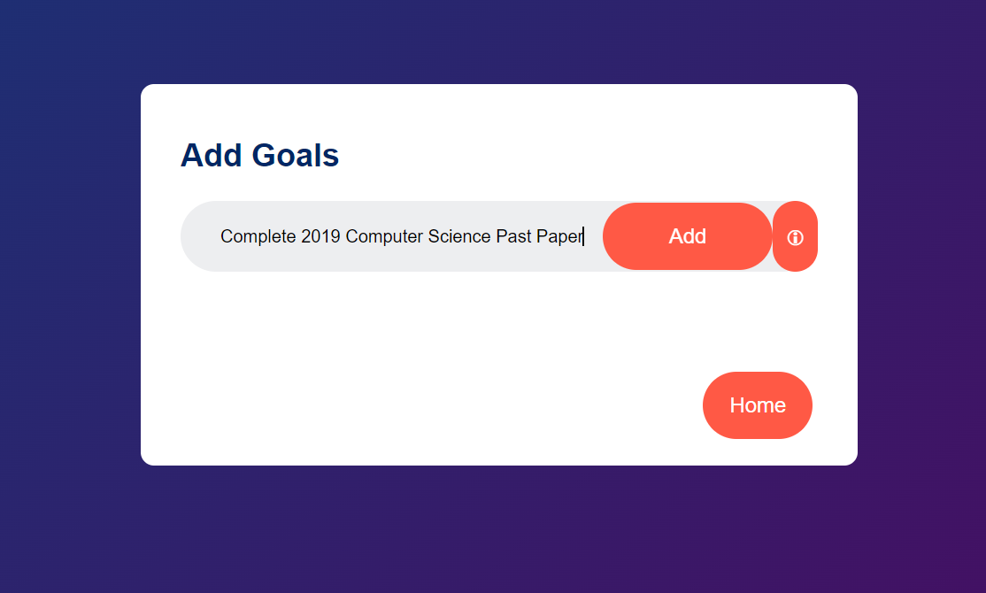
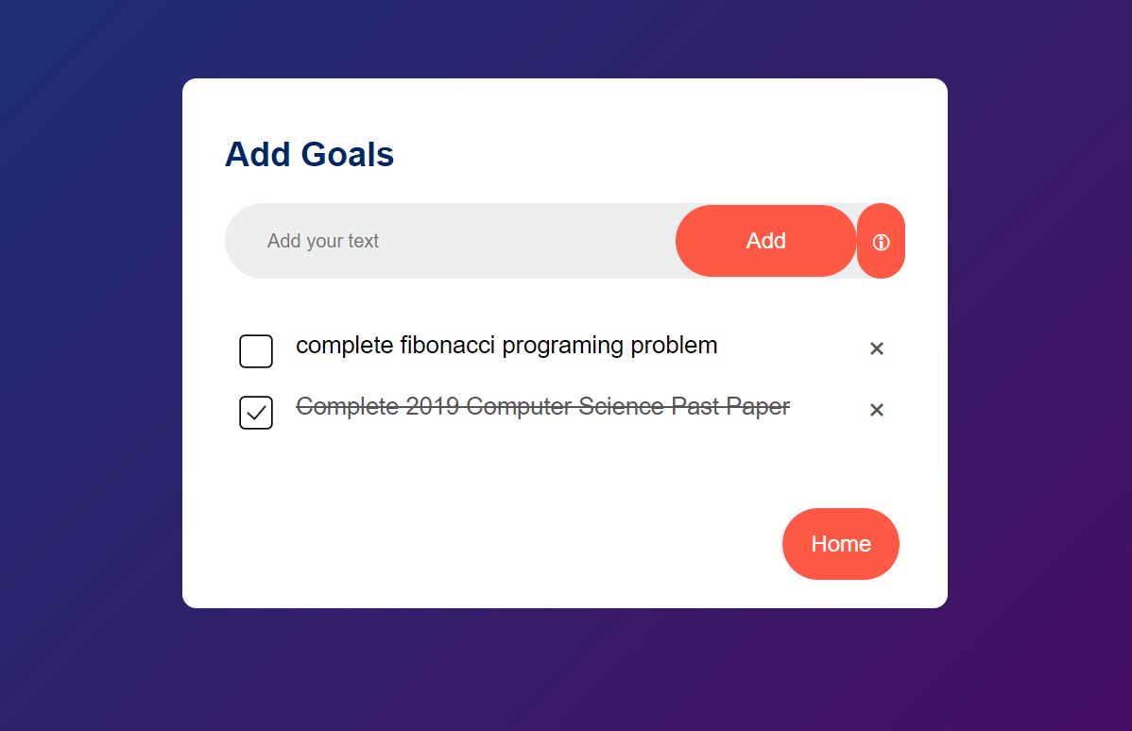
Mark goals as completed or delete them
Add new goals

